Slide 1

Center for Development of Advanced Computing - Patna
“ Unity Life Insurance Company ”
By
Mr. Shubham Panale (2209807200105)
Mr. Dipak Chaudhari (220980720033)
Mr. Bhagyesh Chaudhari (220980720025)
Mr. Shubham Sapkale (2209807200106)
Mr. Vijay Patil (2209807200111)
Mr. Harshal Nikam (220980720066)
Guided By
Prof. Ashutosh Jha

Slide 2
Introduction
Welcome to our presentation on Unity Life Insurance Company . The Company has been developed to override the problems prevailing in the practicing manual system. This software is supported to eliminate and in some cases reduce the hardships faced by this existing system. Moreover this system is designed for the particular need of the company to carry out operations in a smooth and effective manner.
The application is reduced as much as possible to avoid errors while entering the data. It also provides error message while entering invalid data. No formal knowledge is needed for the user to use this system. Thus by this all it proves it is user-friendly. This application, as described above, can lead to error free, secure, reliable and fast management system. It can assist the user to concentrate on their other activities rather to concentrate on the record keeping. Thus it will help organization in better utilization of resources.

Slide 3
Agenda
Introduction
Methodology / Techniques
Implementation
Results & Conclusion
References

Slide 4
Methodology and Techniques
Functional Requirements
Hardware Platform:
• Processor: Above Pentium 4, with clock speed of 2.0 GHz
• RAM: 2GB or Above
• Hard Disk: Free disc space above 1GB
Software Platform:
• Front End: Bootstrap, ReactJS.
• Back End: MySQL, Spring Boot Framework.
Supported Tools:
• MySQL Workbench, Eclipse, STS.
• Web Server: Tomcat 9.0.

Slide 5
IMPLEMENTATION
Modules Description:
In Our Application We divided entire project in three Modules :
Manager (Admin)
Agent
Customer

Slide 6
IMPLEMENTATION
1. Manager (Admin)
The Managers of the different branches recruits the Agents and also registration of customers. He is also responsible for registration of Policies, calculate the premium amounts, interests, dues, bonus and also agent Commission. Bonus calculate based on the payment of premiums. The Manager also responsible for calculate the Agent Commission based on Agent performance.
The Manager is responsible for the :-
Manages the Agents
Customer Registrations
Customer Policy Registrations
Customer Premium Payments
Customer Bonus
Agent Commission

Slide 7
IMPLEMENTATION
2. Agents
The main role of Agents is to registration of the Customers. Agents just like a mediator between Insurance system and Customers. Based on their performance they will get commission. These systems provide a facility to Agents like to visible their Commission and also their customer details.
The responsibilities of the Agents as follows
Involves in the Customer Policy Registration Process
Agent Personal Details
Manager Details

Slide 8
IMPLEMENTATION
3. Customer
The Customers are a main source of this system. Based on his interest and benefits, he takes a policy. Customers also take more than one policy based on their requirement. Here so many facilities are provided to the Customers, like their information visible on line, like premium dates, bonus dates, personal details, policy details.

Slide 9
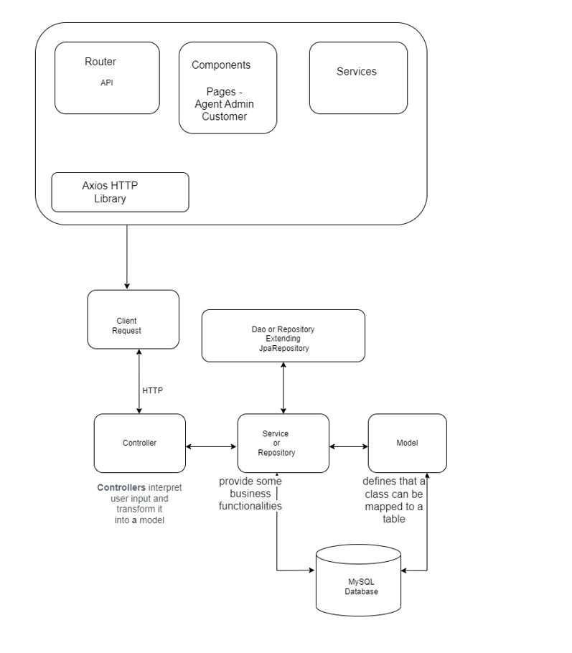
Data Flow Diagram

Slide 10
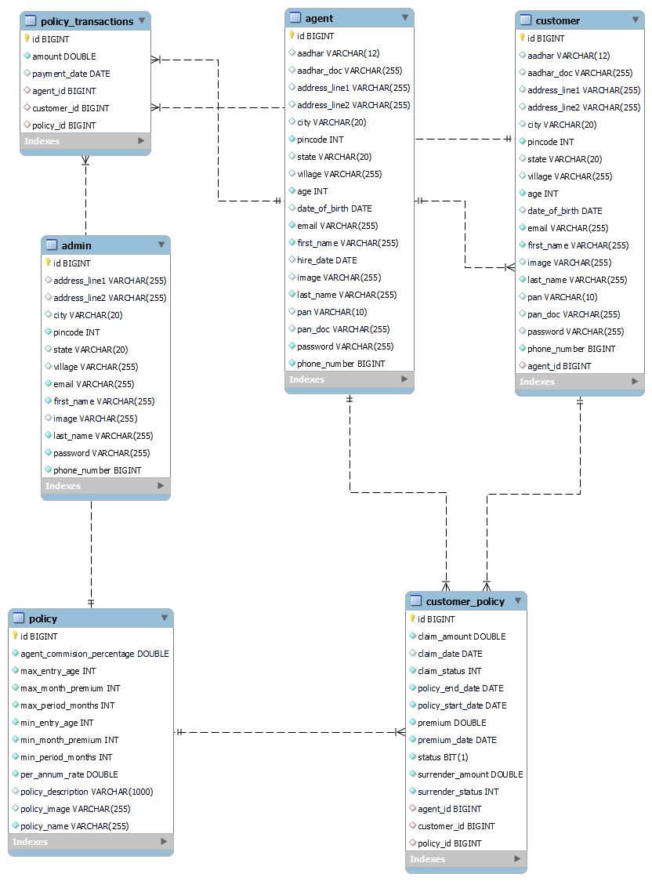
E-R Diagram

Slide 11
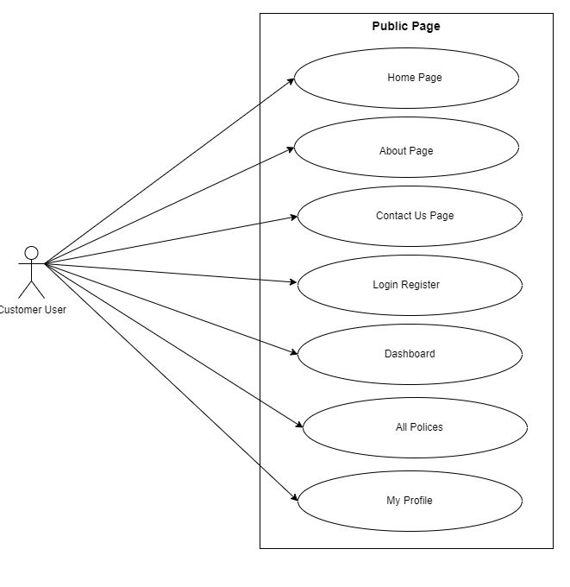
Use Case Diagram
Customer Use Case Diagram

Slide 12
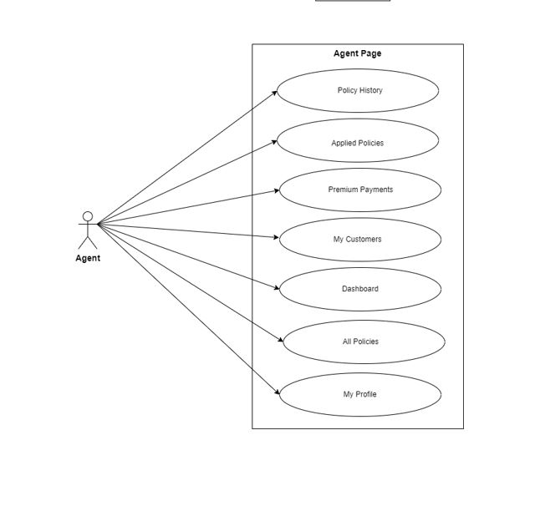
Use Case Diagram
Agent Use Case Diagram

Slide 13
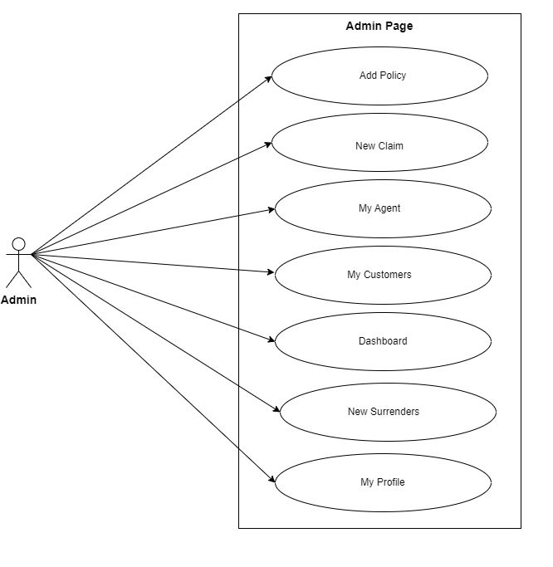
Use Case Diagram
Admin Use Case Diagram

Slide 14
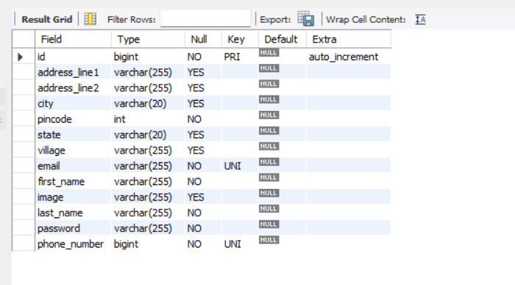
MySQL Table Structure
Manager as Admin

Slide 15
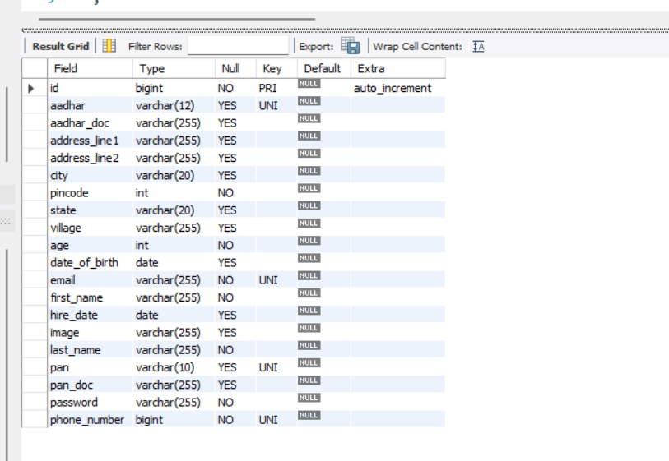
MySQL Table Structure
Agent

Slide 16
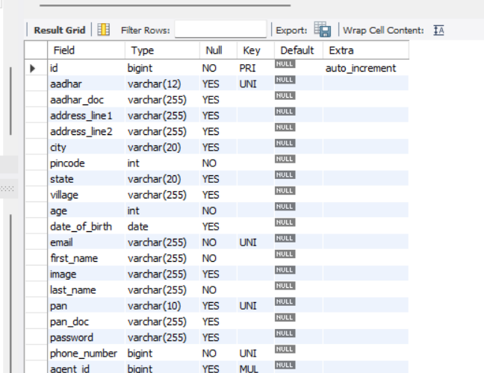
MySQL Table Structure
Customer

Slide 17
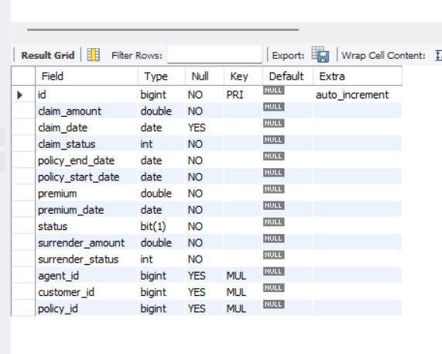
MySQL Table Structure
Customer Policy

Slide 18
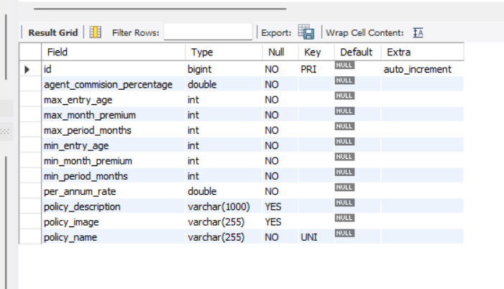
MySQL Table Structure
Policy

Slide 19
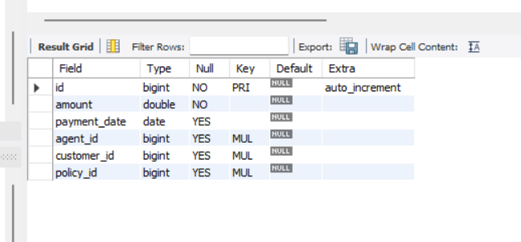
MySQL Table Structure
Policy Transaction

Slide 20
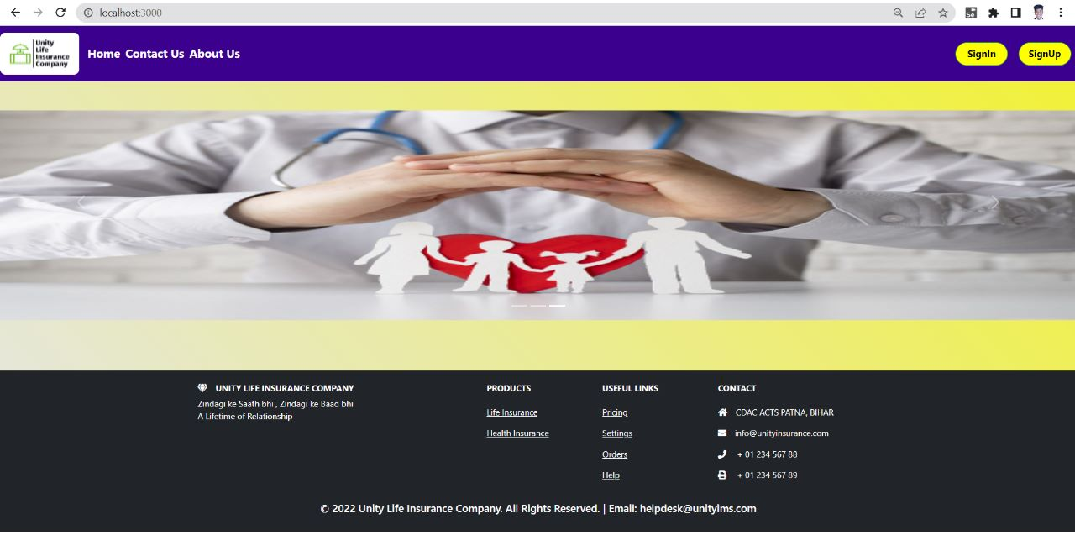
Snippets
1. Home Page

Slide 21
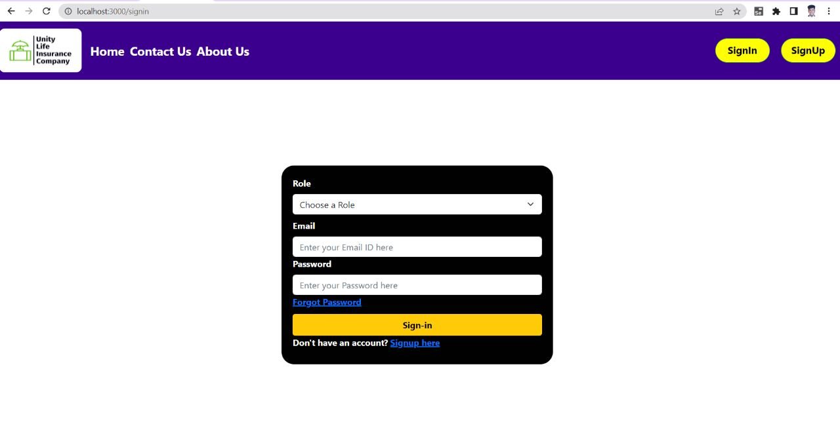
Snippets
2. SignIn Page

Slide 22
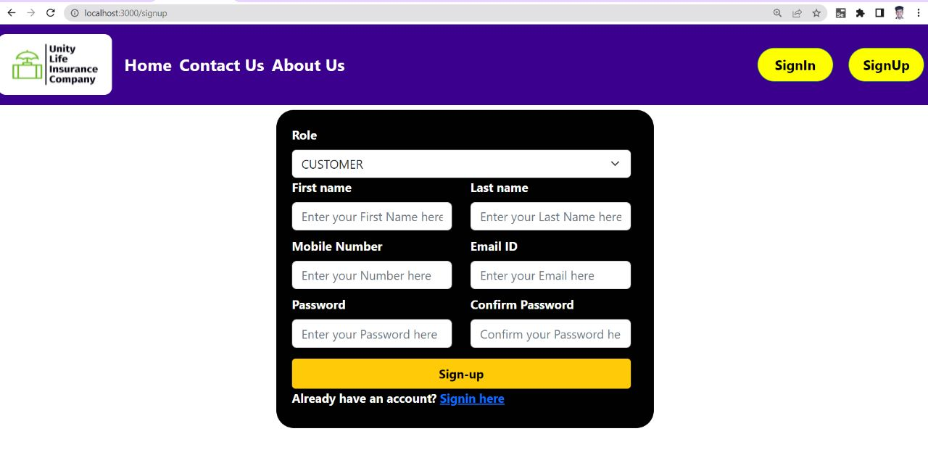
Snippets
3. SignUp Page

Slide 23
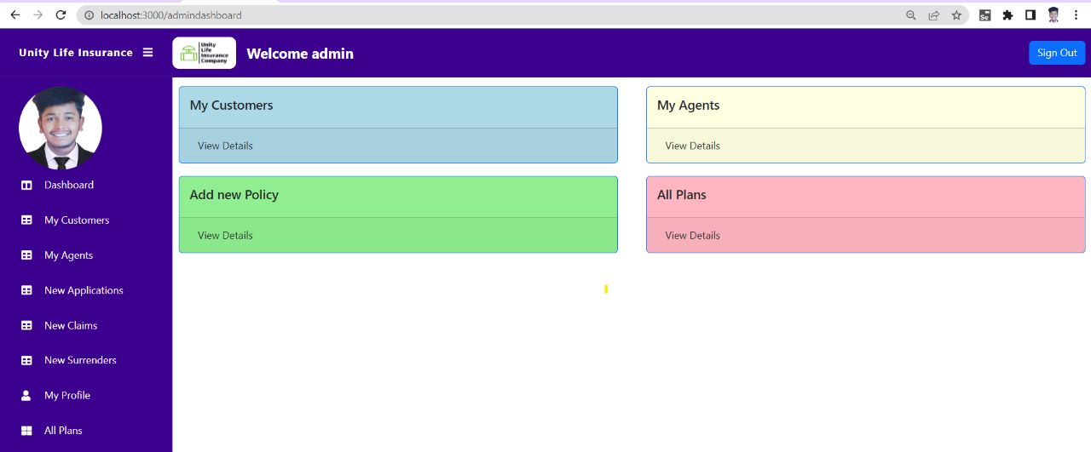
Snippets
3. Admin Dashboard

Slide 24
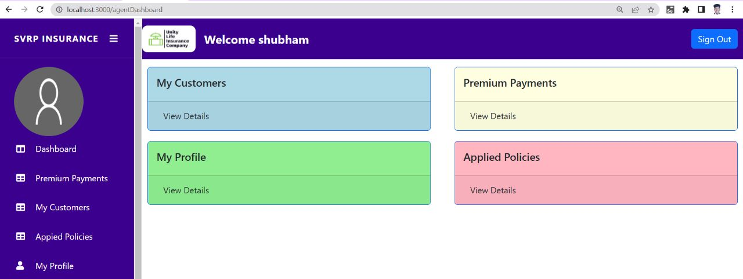
Snippets
4. Agent Dashboard

Slide 25
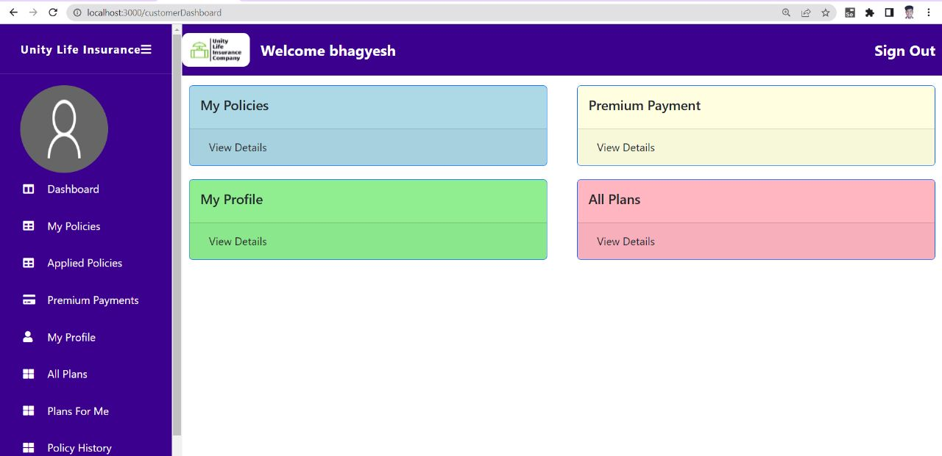
Snippets
5. Customer Dashboard

Slide 26
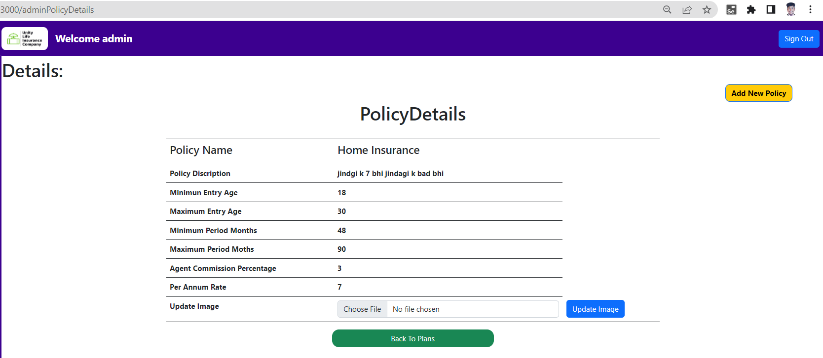
Snippets
Policy Details

Slide 27
CONCLUSION
A computerized insurance management system has been developed and the system was tested with sample data. The system results in regular timely preparations of required outputs. In comparison with manual system the benefits under a computer system are considerable in the saving of man power working hours and Effort. Provision for addition , updation and deletion of customers is there in the system .It is observed that proper filing system has been adopted for future refernce . The entire project runs on windows environments. The system can be used to make better management described at appropriate time. The user gets amount and timely information system.The Online Insurance supports and improves many of the core functionality of the insurance organization i.e. insurance project helps in quick easy monitoring of the reports that have been automatically generated as and when the admin and policy agent performs transactions in the system. Using such a system helps the organization in minimizing the time consumed in fulfilling the day-to-day functionality’s and cutting down the expenses incurred on the same.

